Slide 1
Solution Plan
IDEA0005744/DMND0010214
MENA Rewards Portal
IS Basic
Document Version 1.1 | 23 November 2021
Vijin P Zacharia
Integration Services
MSPT v2.8.7 | GST v1.7
(Master SP Template) | (Gold Standard Template)
Technical Solutions Manager | CT Solution Architecture

Slide 2
Contents
Business Executive Summary – Scope
Business Executive Summary – Costs & Timelines
Architectural Significant Requirements Realization
Logical Infrastructure Diagram
Cost Estimation Summary
Resource Plan
Infrastructure Cost Breakdown
EY Mandatory Policies and Security Requirements
Risks
Assumptions
Responsibility Matrix
Next Steps
Appendix

Slide 3
Business Executive Summary – Scope
1
Problem Definition
MENA Rewards Portal is an one stop solution for the rewards team to manage the business processes/activities for the employees to understand total value of the organization is offering to them. Currently all activities managed by MENA rewards team are done using excel/local repositories and using multiple systems manually. Business require a consolidated portal for handling the above process and the team would like to host this solution in EY’s Azure Cloud Platform. The engagement team would like to deploy their QA/UAT/PROD solutions in Azure.
Team activity:
Prepare cost estimation for this solution based on the existing IAD.
Deploy Azure resources as per the IAD for QA,UAT and PROD Environments.
2
3
In Scope
Out of Scope
Estimate for resource and cloud hosting costs for QA,UAT and PROD cloud environments.
CBS RIOT Integration team will perform the build and provisioning activities as per the agreed Infrastructure Architecture Diagram.
Application Development, Configuration, Deployment and Support
Azure Data Factory (ADF) Deployment
Application License Procurement
Application integration
Data Migration
Repeatability/Pipeline
InfoSec/PIA/BIA cost are to be included as a Part of PM/SDM efforts accordingly
Notes:
Test the DR

Slide 4
Business Executive Summary – Cost & Timelines
4
Overall Invest Cost
Overall Operate Cost
US $2.9K
US $41K
Year One (2021): $2949
Year One (2021-2022): $10240
Year Two (2022-2023): $15360
Year Three (2022-2023): $15360
Timeline
Project Duration (KEY DELIVERABLES / MILESTONES)
5
# | Milestone | Description | Core (Y/N) | Duration non-concurrent
1 | Initiation/Planning | Scope, requirements, various process approvals (PIA, BIA, InfoSec, etc.) and architecture approved | Yes | NA
2 | Build | Environment set up and availability | Yes | 2 Weeks
3 | Execution | Application build and deployment | No | Project Specific
4 | Go-live | Infrastructure go-live | Yes | NA
5 | Close | Lessons learned, closeout documentation, support documentation sent | Yes | 1 Week
Note: All applicable “EY Mandatory Policies and Security Requirements” must be planned in the project plan & addressed in initiation/planning phase to ensure they are completed before Go-live.

Slide 5
Architectural Significant Requirements Realization
# | Functional Requirement | Technical Requirement | Realization | Accountable/ Ownership | Re-Use?
1 | Deliver offering as a managed service | CTP | CTP Platform – IS Basic – QA,UAT and PROD Location : North Europe | CTP Platform | Y
2 | PaaS | *Azure Data Factory (future requirement) | Components to be build – Azure Data factory V2 | RIOT Integration team | Y
3 | PaaS | Azure Key Vault | Components to be build – Azure Key Vault, Standard SKU | RIOT Integration team | Y
4 | PaaS | Azure SQL Database | Components to be build – Azure SQL Database | RIOT Integration team | Y
5 | PaaS | Azure Blob Storage Account | Components to be build – Azure Storage Account | RIOT Integration team | Y
6 | PaaS | Azure Front Door (Web Application Firewall) | Components to be build – Azure Front Door | RIOT Integration team | Y
7 | PaaS | Azure WEB App Service (OS: Windows) | Components to be build – Azure ASP and 2*App Service | RIOT Integration team | Y
*Note:- Azure Data Factory(ADF V2) depicted in the diagram is only for reference. It is marked for future purposes and the same you can see in the IAD legend. ADF is out of scope for this version of Solution plan.
S

Slide 6
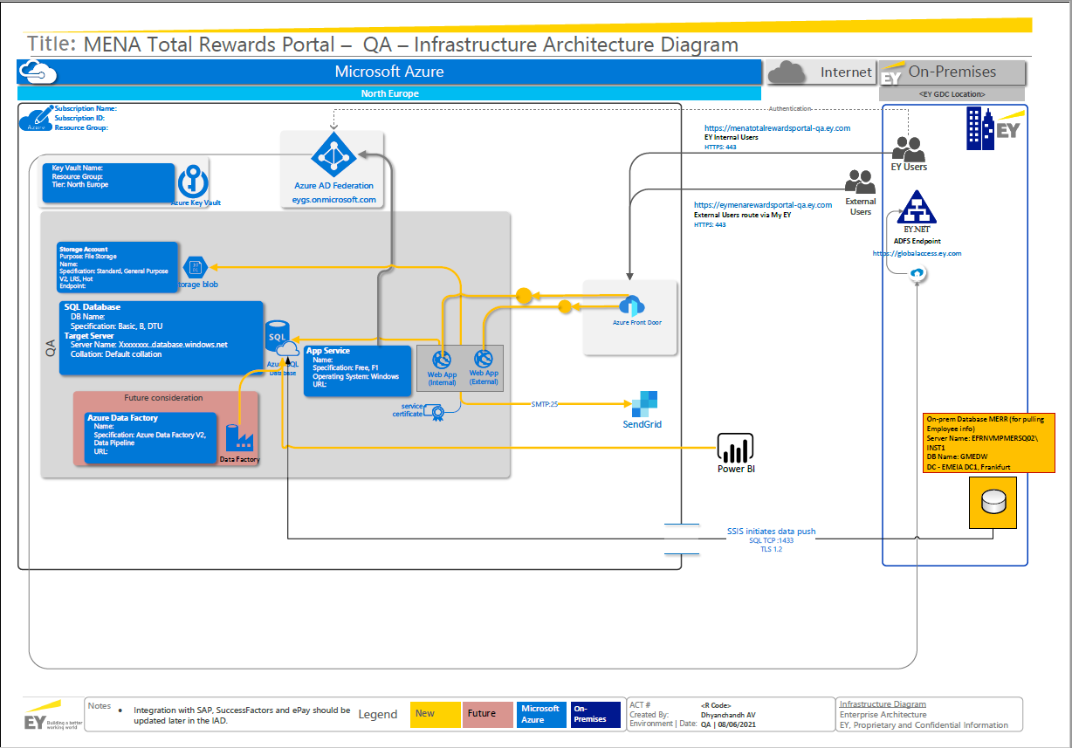
Logical Infrastructure Architecture Diagram – QA

Slide 7
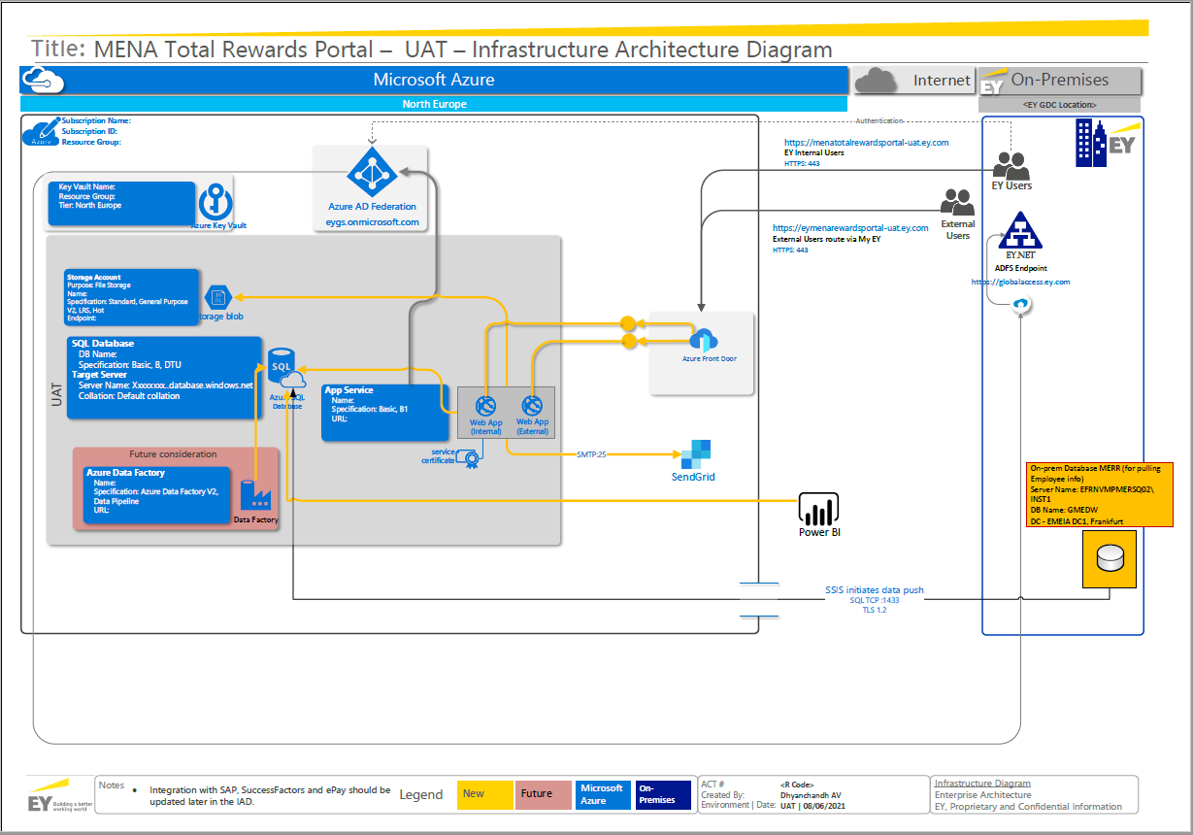
Logical Infrastructure Architecture Diagram – UAT

Slide 8
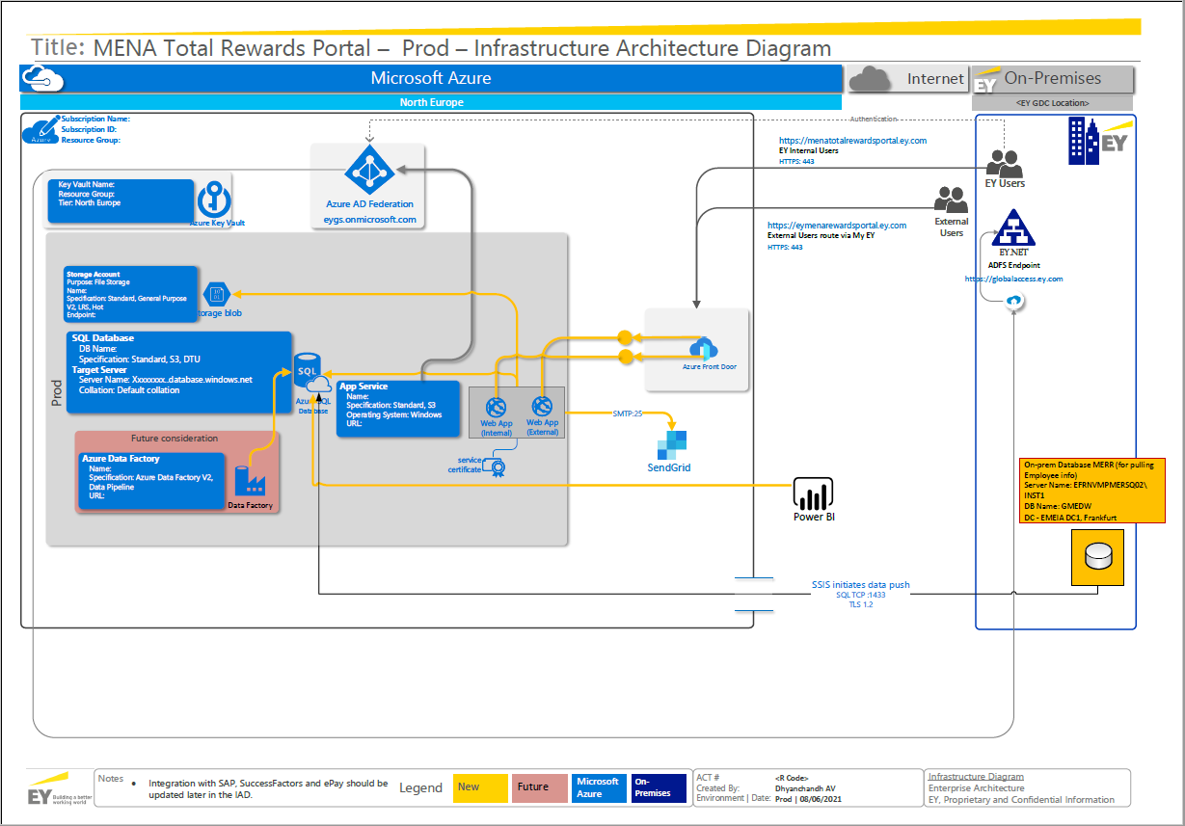
Logical Infrastructure Architecture Diagram – PROD

Slide 9
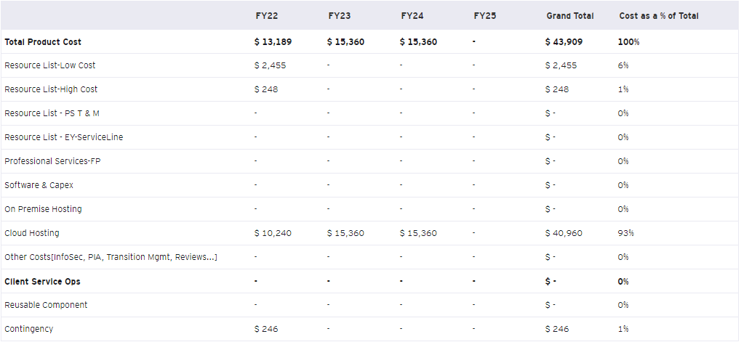
Cost Estimation Summary
Contingency of 10% applied to Resource cost
Contingency of 10% applied to Cloud Hosting cost

Slide 10
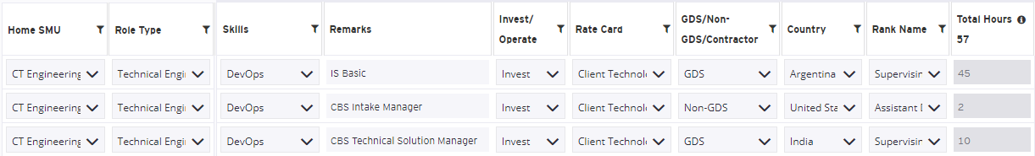
Resource Plan
Effort hours estimated is based on the current assumptions and tasks to be performed. This may vary as work is being performed and will be highly dependent on the project scope/prioritization.
Resource request should be raised by assigned CT Project Manager/CT Product Manager. (Follow the standard process)

Slide 11
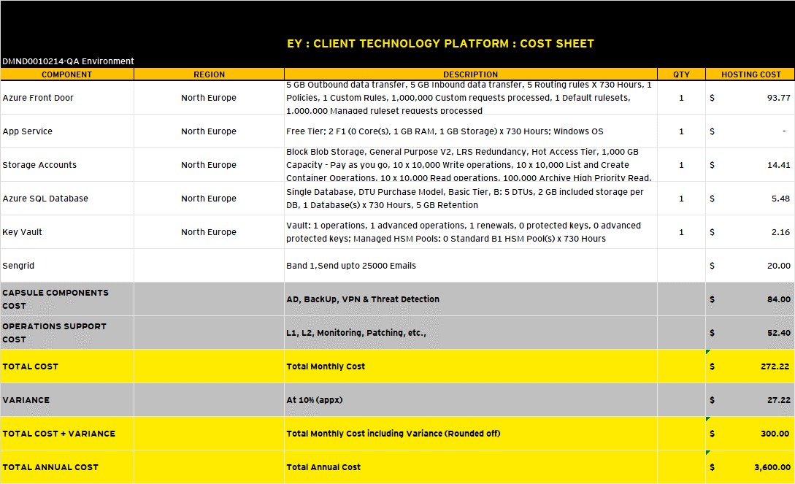
Infrastructure Cost Breakdown – QA
Variance of 10% applied to the hosting cost

Slide 12
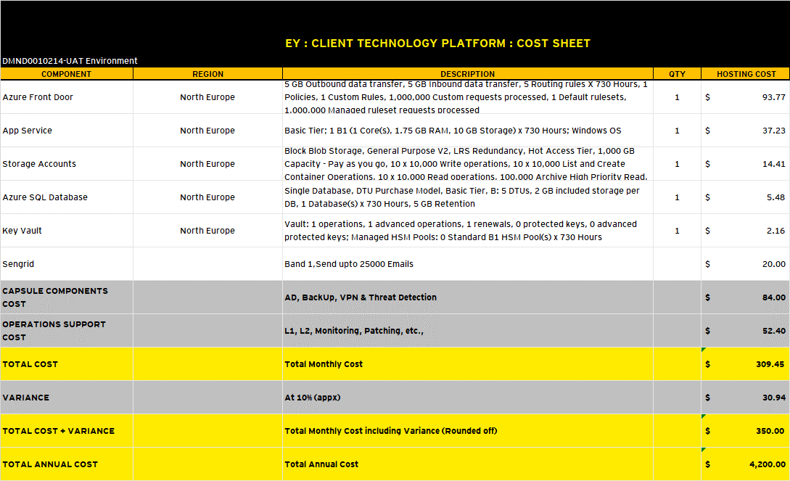
Infrastructure Cost Breakdown – UAT
Variance of 10% applied to the hosting cost

Slide 13
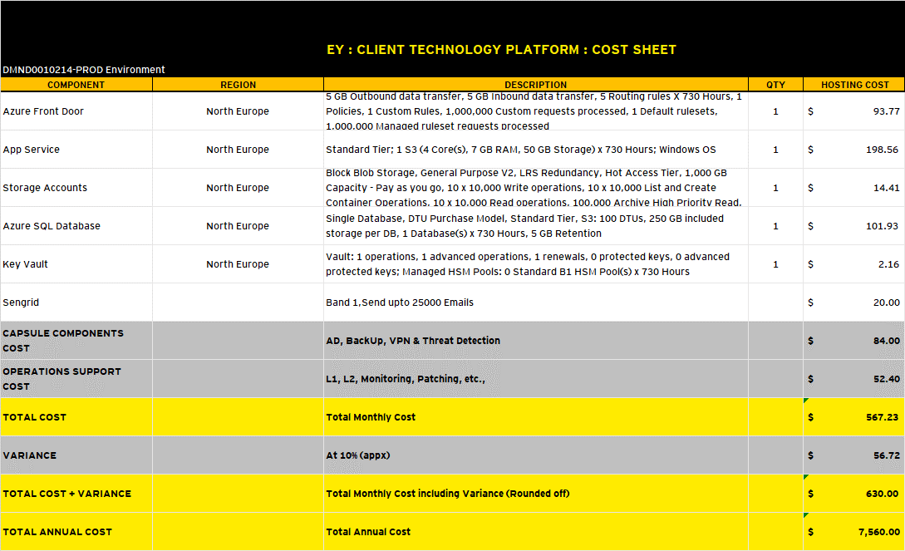
Infrastructure Cost Breakdown – PROD
Variance of 10% applied to the hosting cost

Slide 14
EY Mandatory Policies and Security Requirements
Where applicable, the following EY policies & security requirements must be met for all digital assets developed by/for EY. Disclaimer: The need for certain policies, their lead time & cost may vary based on the nature & complexity of the solution. SA needs to use their best judgement and consult in decision making. This is a general list applicable to most products /projects.
# | Approval | Description | Cost | Accountability | Lead Time | Resources
1 | Privacy Impact Assessment (PIA) | Understand and document the various data flows of the system or process and to take appropriate steps so that all applicable data privacy and confidentiality compliance obligations have been taken into account. Note: EY’s Personal Data Protection Global Policy is based on the principles of the GDPR. | NA | Engagement Team | 8 - 12 weeks | Review… Systems (PIA) and Vendor Reviews Personal Data Protection Global Policy Data Protection Community Site PRIVACY BY DESIGN – all solutions must comply.
2 | Business Impact Assessment (BIA) | Understand the business criticality and plan for business continuity for the digital asset. Applicable to all EY digital assets developed for/by EY. | NA | Engagement Team | 2 - 5 weeks | BIA resources | BIA Templates BIA Guidance | BIA FAQ
3 | InfoSec Assessment | Generate a risk profile of an application to define the required security controls and certification. Applicable to all EY digital assets developed for/by EY. | TBD | Engagement Team | 2 weeks prior to product Initiation | OSS resources Key OSS Contacts EY Legal Community Site
4 | Security Certification | Vulnerability testing of application. Generates list of pass/fail and remediation items to be addressed prior to go-live. | TBD | Engagement Team | Request a minimum of 5 weeks prior to Go-live or as soon as solution will be in a production environment | InfoSec Home | Infosec Certification Request Form GRC.EY.Net for SPR Web Inspect Enterprise (WIE) – click here Web Inspect Scan request – Click here
5 | Open Source Software (OSS) | Use of any OSS (Open Source Software) is subject to review and approval of 1. Architecture, 2. Information Security, 3. General Counsel’s Office (GCO) & 4. Independence. | NA | Engagement Team | 3 – 6 weeks from product initiation; once full technology stack is known | OSS Landing Page in TAC OSS Process Documents | OSS Whitelist Key OSS Contacts | EY Legal Community Site
6 | EY Accessibility Compliance | Ensure all EY digital assets are usable by people of all physical, sensory, neurological and cognitive abilities. EY digital technical & procurement personnel will follow WCAG 2.1 AA level standards when building / procuring digital assets. | TBD | Engagement Team | 3 weeks - need to be accounted in build itself. | EY Digital Accessibility Global Policy EY Accessibility Guidelines Accessibility Testing Engagement Process
7 | EY User Experience (UX, XD, BxD) | All digital assets produced by/for EY must comply with EY UX (User Experience) & EY XD (Experience Design) guidelines both of which are part of EY BxD (Better by Design). | TBD | Engagement Team | 3 – 6 weeks from product initiation. | EY Branding – Digital Assets EY UX Style Guide EY Experience Design (XD)

Slide 15
Risks
# | Risk Description | Probability | Impact | Mitigation plan | Owner
1 | Data Privacy: Delays in completing approvals referenced on slide “Mandatory CT Policies and Security Requirements” may delay go-live and project completion. | Medium | High | Plan should be to start as early as possible in the process. | Project Manager/Product Manager
2 | Budget: The estimated budget is based on a ROM. Actual costs are expected to increase/decrease as requirements are further clarified when the project is underway. | High | High | Revisit budget when a detailed plan is available. | Project Manager/Product Manager
3 | Resources: Based on availability. Resource constraints can potentially impact schedule and/or budget. | Medium | High | Project Manager to maintain resource calendar and ensure resources are aligned as required. | Project Manager/Product Manager
4 | InfoSec review is a critical input. Discovery is necessary to identify the severity, impact, and remediation or avoidance of any identified risks or issues. | Medium | High | Get the Infosec Consultant involved early on. | Project Manager/Product Manager
5 | The cost estimation has been done based on the Azure component sizing and IAD confirmed by Business team. Any changes during the actual solutioning will impact scope, time and cost. | High | High | Any deviation needs to be tracked by the engagement PM/Scrum Master for budget overruns, if any, and raise PCRs accordingly. | Project Manager

Slide 16
Assumptions
Assumptions
# | Assumption Description | Potential impact if invalid | Explicit or Implicit? | Validated (Yes/No)?
1 | Mandatory EY processes of PIA and InfoSec to be initiated as early as possible. CT Project Manager can assist once assigned to this project. | Additional time and cost | Explicit | Yes
2 | The estimation is created based on the information provided by the engagement team during intake. Any deviations in the due course will be evaluated for impact of change. | Additional time and cost | Explicit | Yes
3 | A high-level design-architecture is provided showing all components within the environment and data flows within and to/from the environment (including human access).​ | Additional cost | Explicit | Yes
4 | PIA Certification Cost | Based on each Client specific deployment PIA cost will be applied: Category 1 PIAs - 8 weeks US$10K- $22K Category 2 PIAs - 4-6 weeksUS$4K - $12K Existing PIA Updates - US$3K to $10K | Explicit | Yes
5 | Application certification is Engagement team’s responsibility | - | Explicit | Yes
6 | IAD and Specs are created by the CBS architect and that is taken in to account for the Infra costing | Additional time and cost | Explicit | Yes
7 | The solution will be supported by CBS ops managed by the engagement team. Any application level licensing cost will be absorbed by the business. | Additional time and cost | Explicit | Yes

Slide 17
Responsibility Matrix
Client Technology Responsibility
Member Firm / Engagement Team Responsibility
Ensure technical feasibility of the product
Provision requested Infrastructure components and the essential integrations
Ensure MSB (Minimum Security Baseline) is adhered to for all components being provisioned
Ensure security and compliance requirements are met upon deployment
Ensure standard Operations and Security Monitoring is configured on all the Azure components
Create, and manage solution artefacts during the process of co-development solution lifecycle (e.g. solution components, etc.)
Create, maintain, and distribute technical documentation relevant to the solution
Create minimum set of documentation and knowledge articles for L1/L2 support
In the ‘Run’ state, CTPE and CSO (Client Services Operations) teams will collaborate to provide L1/L2/L3 support of the platform components.
Transition Management activities
Product Owner and Scrum master roles
Application development
Scrum team resource management
Product Backlog management
End client contract management
Application development vendor management
Application level Information Security assessment
3rd party endpoint integration support
Support for middleware installed on top of the Infrastructure
Engagement requester is responsible Infosec approval before going live with the solution.
Engagement team to ensure application support model is enabled for the solution.
The Member Firm/Engagement team will be accountable for reviewing and accepting residual risks, and for any disclosure and/or acceptance of residual risks with end Client.
The Member Firm/Engagement Team will also remain at all times accountable for any aspects of the service and/or operating model provided by Member Firm, including compliance with all applicable EY Policies and Standards.
The Member Firm / Engagement Partner / Engagement Team is accountable and responsible for ensuring that all personal data added to the solution is done so in compliance with Client contracts, local laws and regulations, and EY Policy.

Slide 18
Next Steps
Item 1: PPEDD with authority to approve the solution plan/estimation and informs CBS Service Line Product Manager of approval or rejection.
Item 2: If PPEDD approves to move forward:​
Business must provide the engagement code before resources can be requested
CT will subsequently request a CT engagement code (expected timeline is 7 to 10 business days)
Resources cannot begin working until the CT engagement code is set up
Resource assignment is based on availability and current demand
Item 3: Upon set up of the Engagement Code and the EPPM ID, Pd.M., and/or newly assigned PM will perform a warm handover to the requesting team.
Item 4: The newly assigned Project Manager along with the business team will assume responsibility of the request as scoped.​

Slide 19
Appendix

Slide 20
Appendix – Document History
Revision History
# | Date | Version | Author | Title | Revision Summary
1 | 18 November 2021 | 1.0 | Technical Solutions Manager | CT Solution Architecture | Initial Solution Plan
1 | 23 November 2021 | 1.1 | Technical Solutions Manager | CT Solution Architecture | Added 2 Web, SendGrid and New SQL SKUs
3
4
5
Review History
# | Date | Version | Author | Title | Review Summary
1
2
3
4

Slide 21
Appendix – Key Contacts
Project/Product Team
Business
# | Name | Team / Role
1 | Shobith Muraleedharan | Project Manager
2
3
4
5
# | Name | Team / Role
1 | Peter Makszin | Stakeholder
2 | Karthika Radhakrishnan | Stakeholder
3 | Dhyanchandh Av | Stakeholder
4
5
Engineering Team
CTSA
# | Name | Team / Role
1 | Anjush V P | Project Engineering Team
2
3
4
5
# | Name | Team / Role
1 | Vijin P Zacharia | Technical Solutions Manager
2
3
4
5

Slide 22


Thank you!

